Slide 1
Hotels Dataset
MGSC 310 - 02
Arshia Sarma | Betsy Heredia | Kayla Cho | Nawal Alasmari

Slide 2
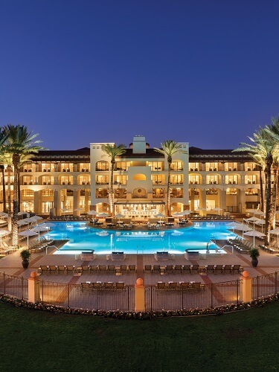
About this template
Motivation
Determine which factors would affect a hotel business and advance their profit
Focusing on predicting why customers would cancel their reservation
The more guests that cancel = less profit earned
Useful for hotels to find which factors of their operation to improve on to keep customers from cancelling
Profits will increase as more guests stay committed

Slide 3
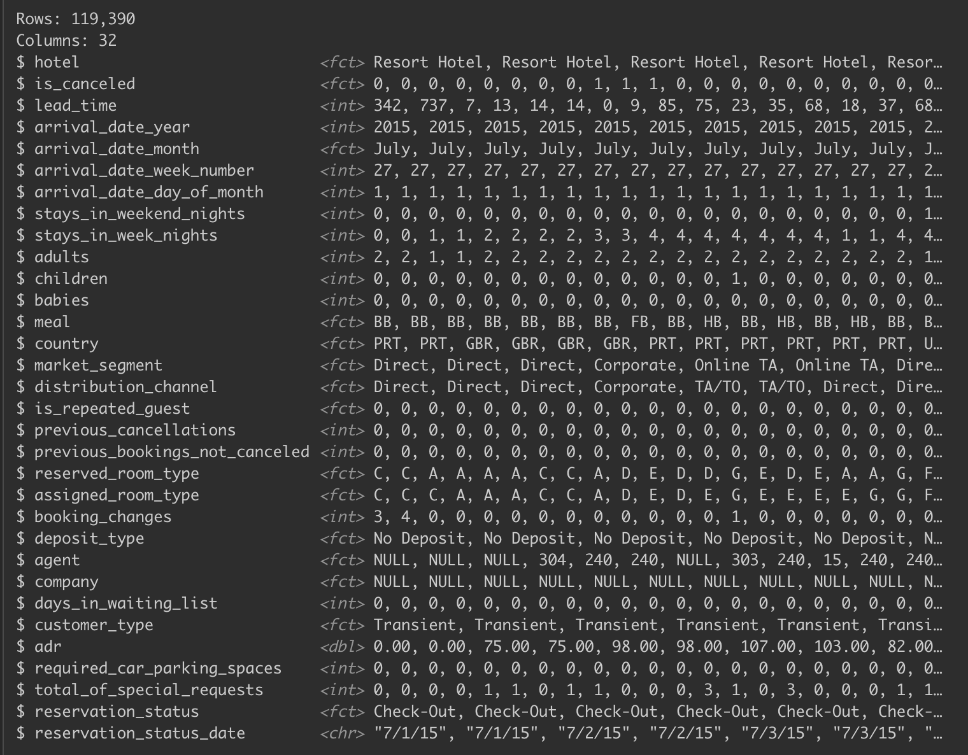
Exploratory Analysis & Summary Stats
Dataset consists of information from hotels from Portugal
Total dataset → 119,390 observations and 32 columns
Pruned variables agent, company, country,
reservation_status, and reservation_status_date
37% cancelled their reservation (for is_canceled)
After pruning, we also upsampled our model
with more repeated copies of our minority class

Slide 4
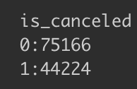
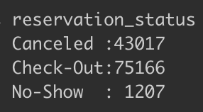
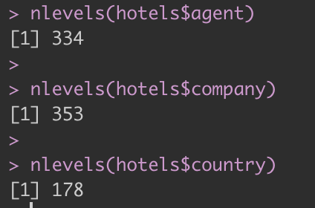
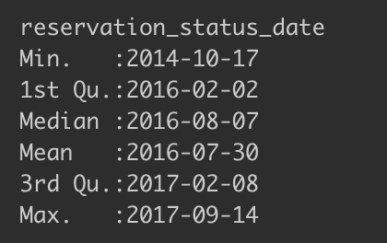
Exploratory Analysis & Summary Stats
Multicollinearity
Total of 865 factors from agent, company and country

Slide 5
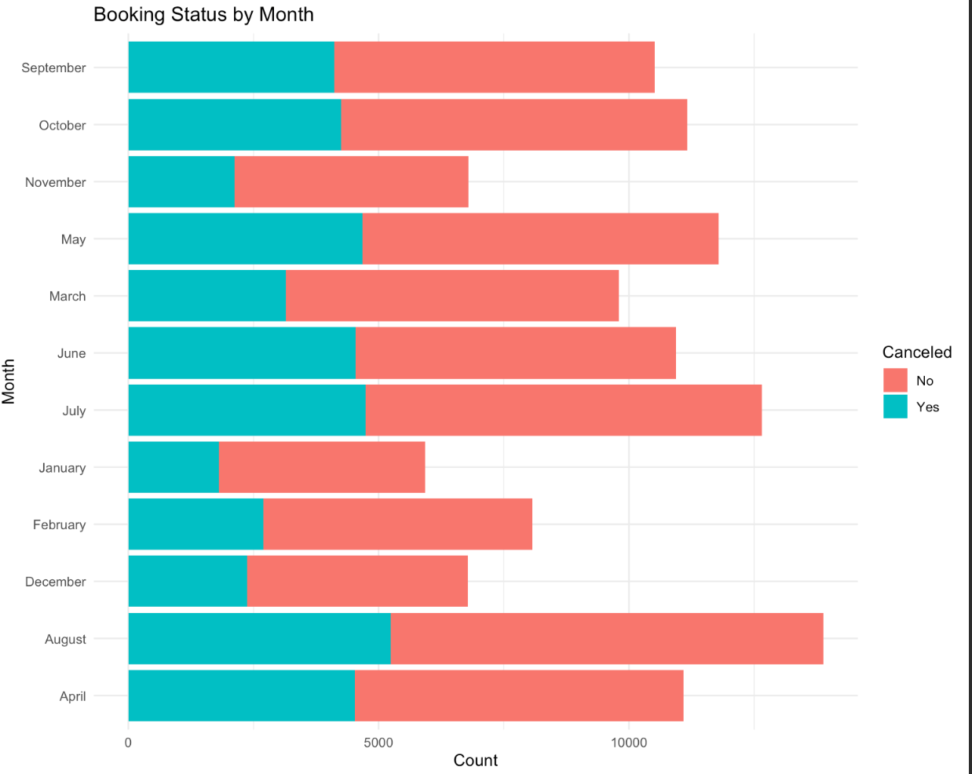
Data Visualizations: Booking Status v. Month

Slide 6
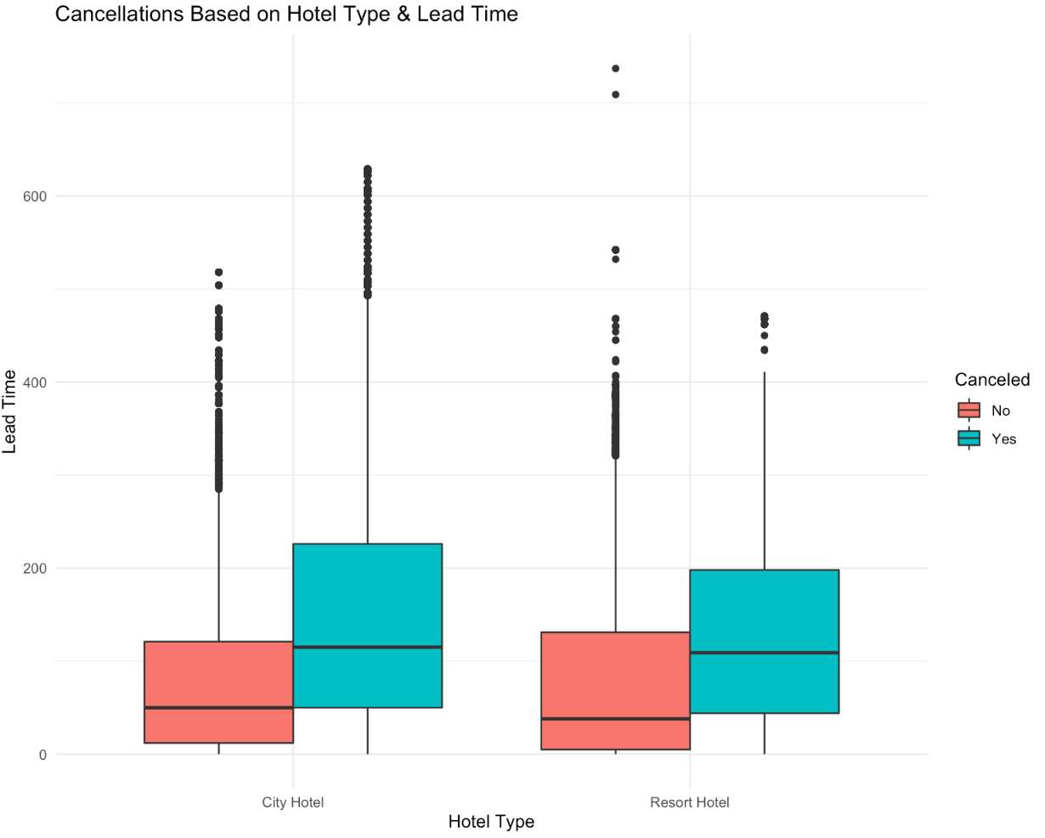
Data Visualizations: Hotel Type v. Lead Time

Slide 7
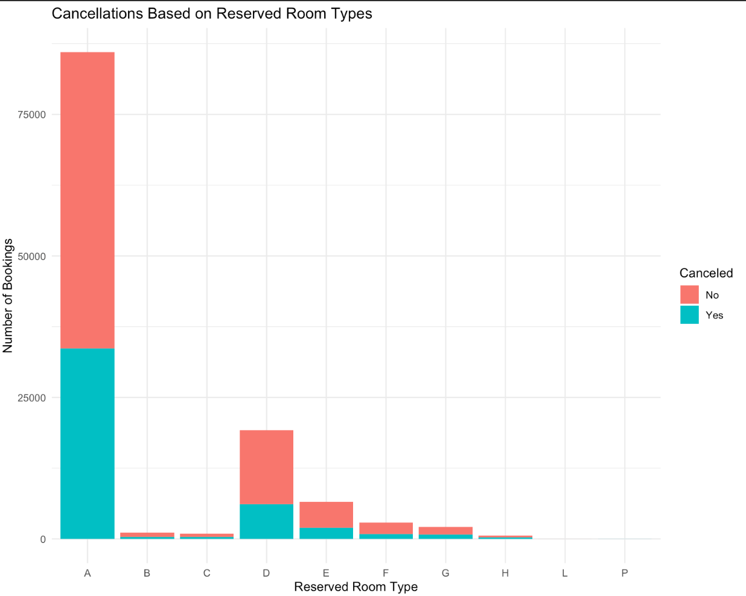
Data Visualizations: Cancellations v. Room Type

Slide 8
You can also split your content
Logistic Model #1
Predicting the categorical outcome of if a guest canceled their reservation
Confusion matrix of training and test
Training
Test
Training
Accuracy: 75.32%
Sensitivity: 68.31%
Specificity: 82.35%
 | Truth
P R E D I C T I O N |  | 0 | 1
 | 0 | 41,104 | 10,603
 | 1 | 19,073 | 49,486
 | Truth
P R E D I C T I O N |  | 0 | 1
 | 0 | 10,175 | 2,620
 | 1 | 4,813 | 12,457
Test
Accuracy: 75.27%
Sensitivity: 67.89%
Specificity: 82.62%

Slide 9
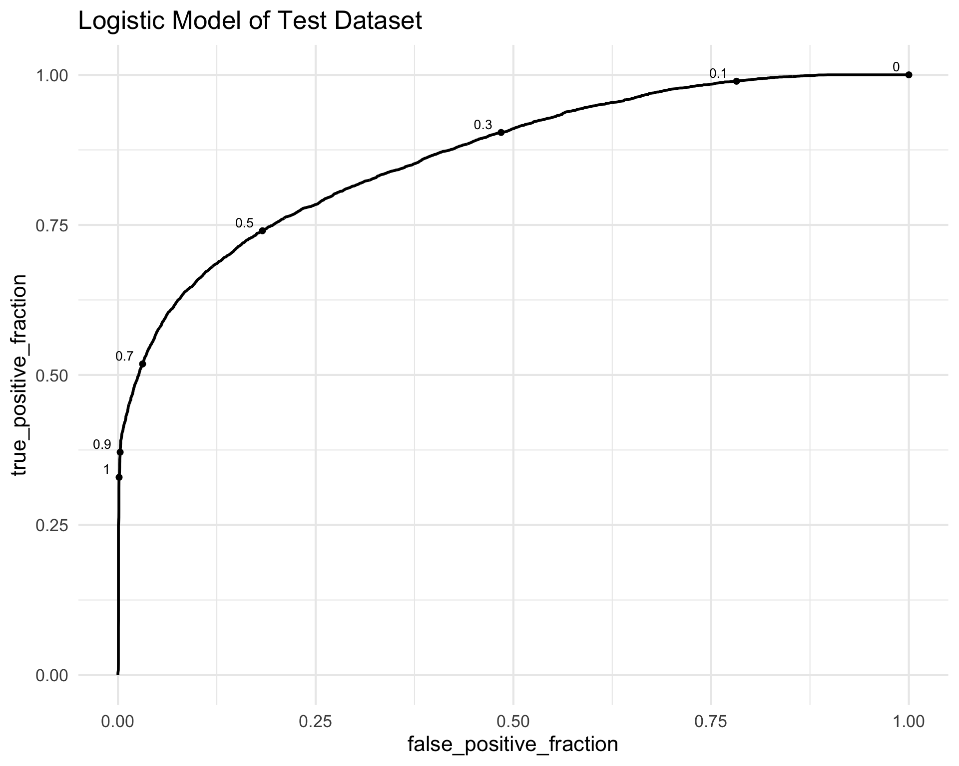
Scores and Takeaways
Conclusions
Not the best model → ~0.26 R2 and average accuracy score
Accuracy, sensitivity, and specificity of the training and test are similar, as well as their R2 and RMSE
 | AUC | R2
Training | 0.8644 | 0.2617
Test | 0.8649 | 0.2609

Slide 10
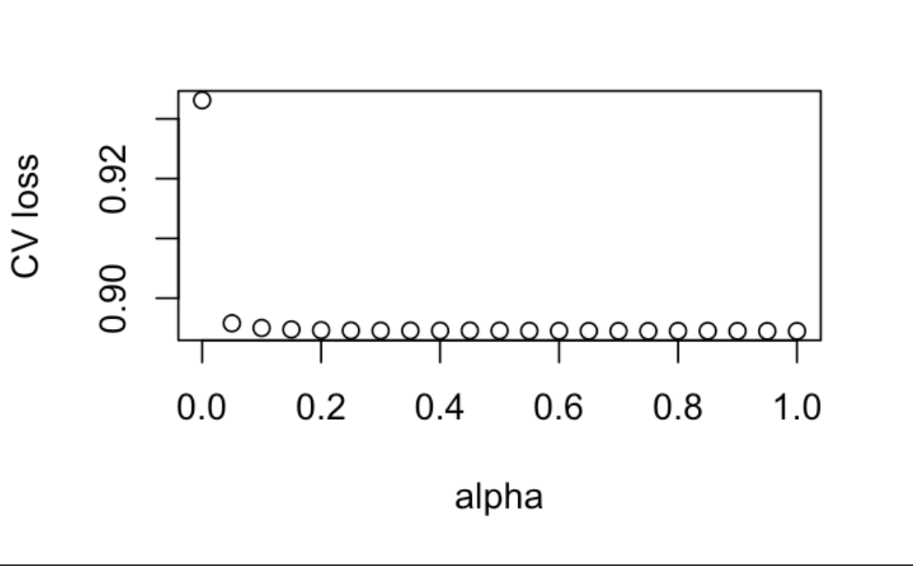
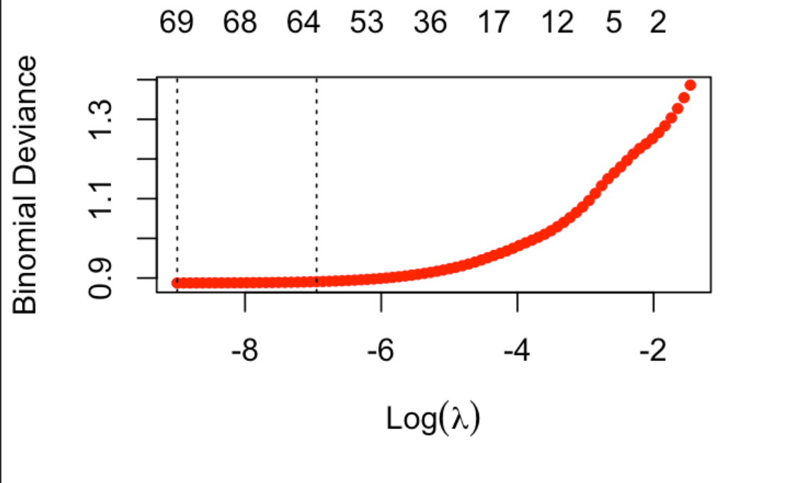
In two or three columns
Elastic Net Model
Binomial Deviance Plot
# coefficients that are non-zero->
Minloss Plot
Lambda min
Optimal Alpha
Lambda 1se
Optimal Model Parameters:
Alpha= 0.95
Lambda min: ~69* coefficients
Lambda 1se: ~64* coefficients
*includes factors

Slide 11
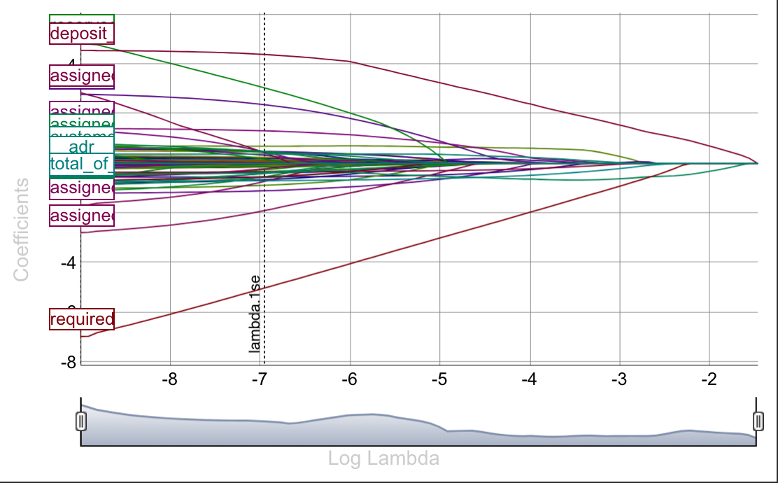
Elastic Net Coefficients
Noteable Coefficients
Coefficients Plot
Required Car Parking Spaces | 5.021
Deposit Type- Non Refund | 4.394
Reserved Room Type- P | 3.048
Previous Cancellations | 2.368
Assigned Room Type - I | -1.9

Slide 12
Elastic Net Coefficients Cont.
Required car parking spaces
Deposit Type
Reserved Room Type
Previous Cancellations
Assigned Room Type
Distribution Channel
Market Segment
Total of Special Requests
Meal
Customer Type
Booking Changes
Previous Bookings
Is Repeated Guest
Adults
Arrival Date Month
24 Variables
16. Guests
17. Hotel
18. Babies
19. Children
20. Stays in Week Nights
21. Stays in Weekend Nights
22. Arrival Date Year
23. ADR
24. Lead time
80 Coefficients -> 61 Coefficients

Slide 13
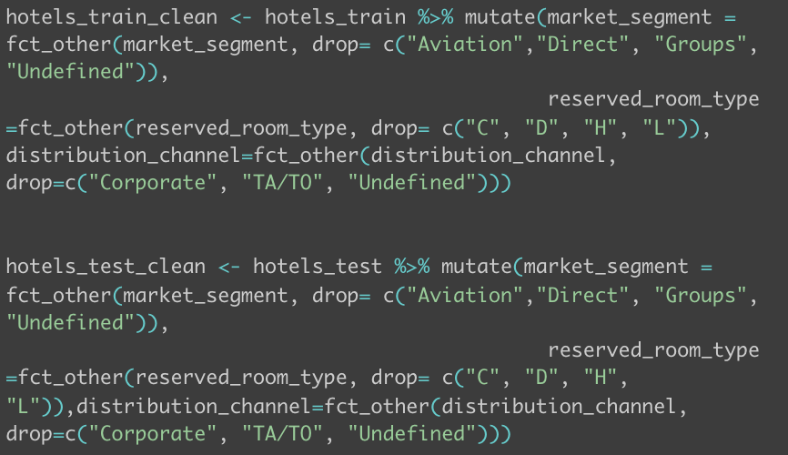
Elastic Net Coefficients Cont.
Non-Important Variables
Days in waiting list
Arrival date week number
Arrival date day of month
Combined Coefficients
Reserved_room_type_Other
Reserved_room_type (C,D,H, L)
- Market_Segement_Other
- Market_Segment (Aviation, Groups, Undefined)
- Distribution_Channel_Other
- Distribution_Channel (Corporate, TA/TO, Undefined)

Slide 14
Elastic Net Model Results
Train | Truth
P R E D I C T I O N |  | 0 | 1
 | 0 | 40860 | 10505
 | 1 | 19317 | 49584
Test | Truth
P R E D I C T I O N |  | 0 | 1
 | 0 | 10135 | 2578
 | 1 | 4853 | 12499
Conclusions
Similar performance as Logistic Regression (Test: 75.27%)
Slightly better test performance
Higher Specificity -> Better at predicting if a booking is not canceled
Accuracy
Train: 75.2033%
Test: 75.2836%
Sensitivity
Train: 67.8997%
Test:67.6208%
Specificity
Train: 82.5176%
Test: 82.9011%

Slide 15
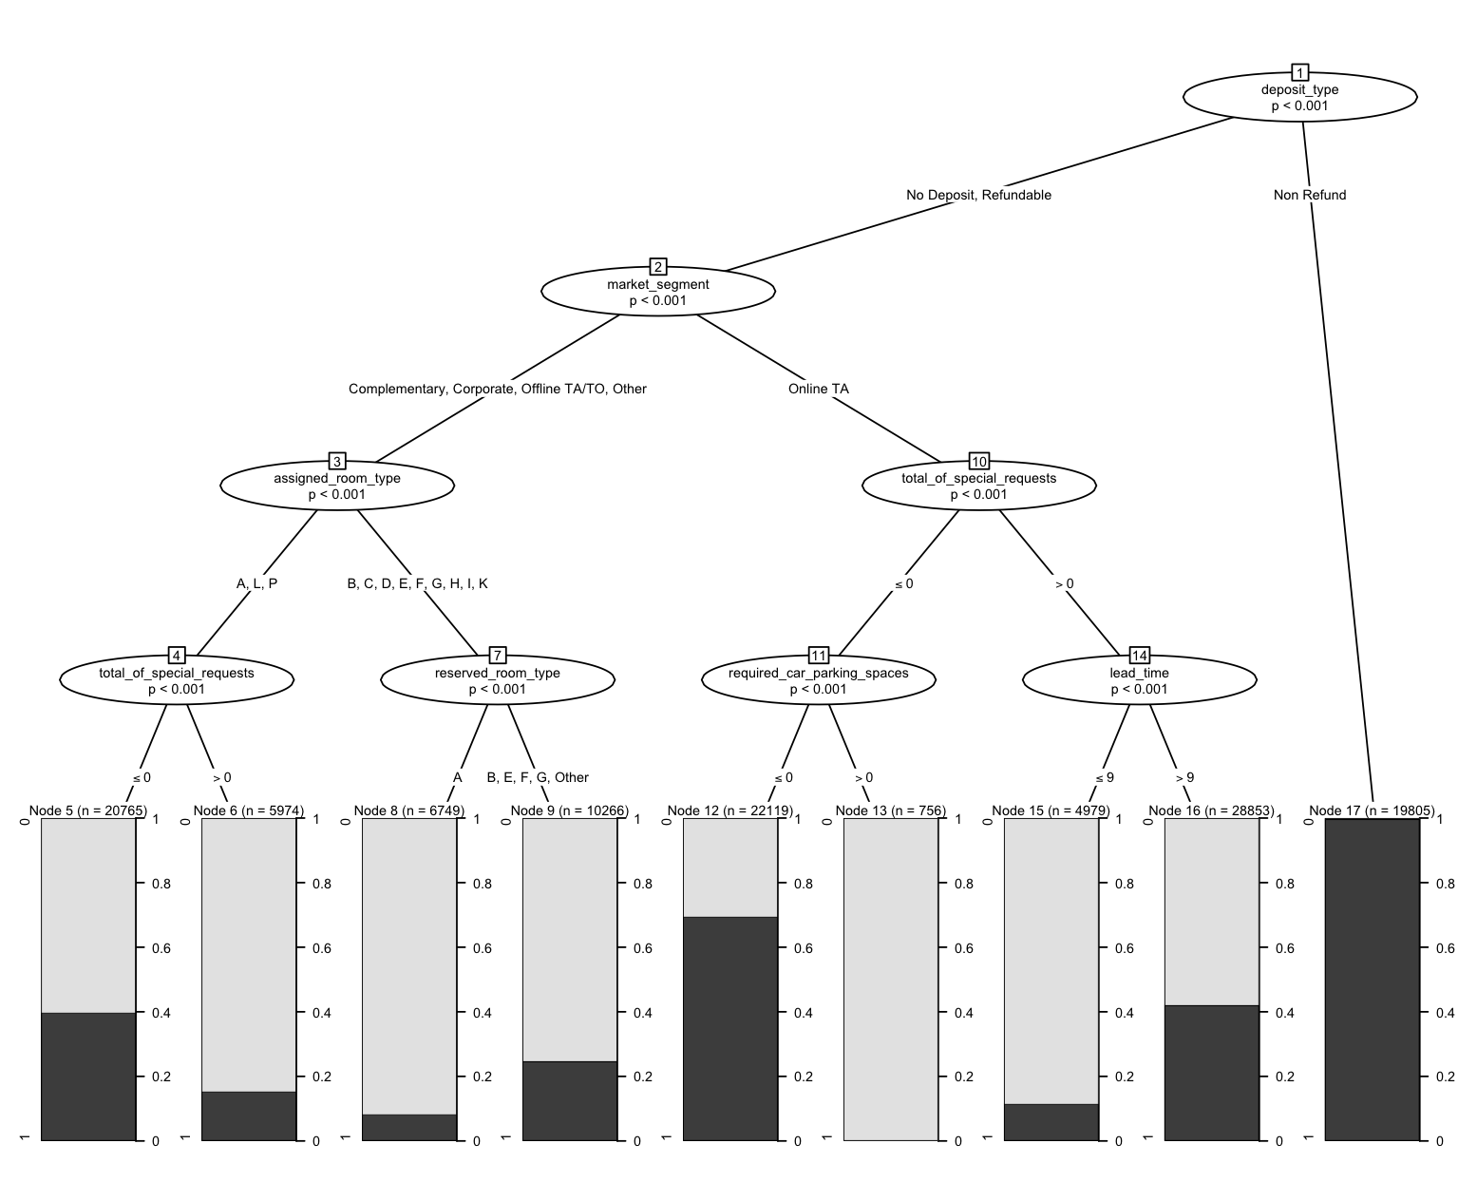
Decision Tree

Slide 16
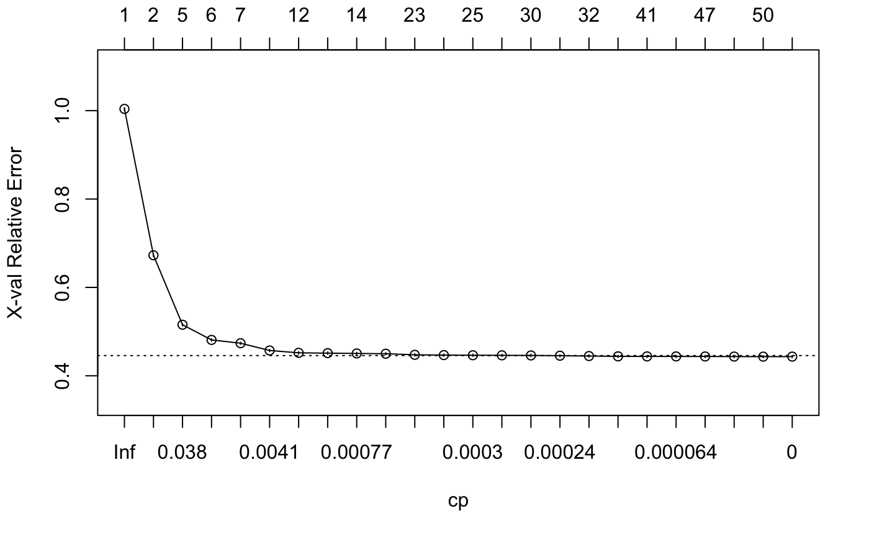
RPart

Slide 17
Decision Tree
Max Depth = 4
Max Depth = 12
 | RMSE | RSQ
Train | 0.5141 | 0.2443
Test | 0.5147 | 0.2438
 | RMSE | RSQ
Train | 0.4427 | 0.3698
Test | 0.4463 | 0.3620
 | Truth
P R E D I C T I O N |  | 0 | 1
 | 0 | 13,280 | 6,257
 | 1 | 1,708 | 8,820
 | Truth
P R E D I C T I O N |  | 0 | 1
 | 0 | 11,932 | 2,932
 | 1 | 3,056 | 12,145

Slide 18
Our process is easy
Comparison of Models
Logistic Model
Accuracy: 75.27%
Elastic Net
Accuracy: 75.28%
Decision Tree
Accuracy: 80.08%

Slide 19
Let’s review some concepts
Conclusion and Final Takeaways
Understand your dataset and what variables you want to predict
Remove outliers, use the entire training sample for the elastic net model and model the outcome variable with a random forest.
Logistic model with all variables performed better than with top 10 variables.
Company should focus on reserve room type and people who cancelled their bookings in the past.
Future directions:
Predict market segment
Predict distribution channel

Slide 20
Thanks!
ANY QUESTIONS?
Team Hotels

Slide 21
Credits
Special thanks to all the people who made and released these awesome resources for free:
Presentation template by SlidesCarnival
Photographs by Unsplash

